Slide 1
Lecture 7
ETHICAL AND SOCIAL ISSUES IN INFORMATION SYSTEMS

Slide 2
Learning Objectives
What ethical, social, and political issues are raised by information systems?
What specific principles for conduct can be used to guide ethical decisions?
Why do contemporary information systems technology and the Internet pose challenges to the protection of individual privacy and intellectual property?
How have information systems affected everyday life?
Notes:
Ask students what their first impressions are after seeing these objectives. Can they point to examples of how information systems have affected everyday life? If not, explain that they will be surprised to learn that information systems affect almost every area of daily life. Can students explain how the Internet poses challenges to privacy and intellectual property? Ask them how Google, Facebook, and peer-to-peer networks are related to these issues. What about breakdowns in important networks and software at banks, air traffic control, and other business firms?

Slide 3
Behavioral Targeting and Your Privacy: You’re the Target
Problem: Need to efficiently target online ads
Solutions: Behavioral targeting allows businesses and organizations to more precisely target desired demographics
Google monitors user activity on thousands of sites; businesses monitor own sites to understand customers
Demonstrates IT’s role in organizing and distributing information
Illustrates the ethical questions inherent in online information gathering
Notes:
Ask students if they know they are tracked on the Web. Would they like to know what information companies like Google have about them? Do they feel comfortable that they can control and manage their online personal information, or, do they feel they have no control over this information? Ask students if they want any privacy anymore. Some experts believe there is no privacy anyway, so why demand privacy now.? Do they think they “deserve” privacy? Why? On what grounds do they claim a “right to privacy?” Where do they think this “right” is located, or secured? The Constitution? Statutory law? After reading this chapter they will be able to answer these and other questions.

Slide 4
Understanding Ethical and Social Issues Related to Systems
Recent cases of failed ethical judgment in business
  Lehman Brothers, Minerals Management Service, Pfizer
  In many, information systems used to bury decisions from public scrutiny
Ethics
  Principles of right and wrong that individuals, acting as free moral agents, use to make choices to guide their behaviors
Notes:
There are numerous examples of business ethical failures to ask students about. You could ask how information systems or their absence might have been related to the current financial crisis in the United States, the investment banks that have suffered heavy losses, and individuals who were able to defraud investors of millions. What role did IS have in this crisis? The Madoff Ponzi scheme is instructive: systems were used for over twenty years to fool investors, regulators, and investigators about the true nature of Madoff’s business.

Slide 5
Understanding Ethical and Social Issues Related to Systems
Information systems and ethics
  Information systems raise new ethical questions because they create opportunities for:
    Intense social change, threatening existing distributions of power, money, rights, and obligations
    New kinds of crime
Notes:
Ask students to describe some of the ethical dilemmas that are presented by information systems and new developments in technology. Privacy is an important issue – mention the opening case again and explain that Google, Facebook, and other similar sites often run into trouble regarding privacy invasions.

Slide 6
Understanding Ethical and Social Issues Related to Systems
Model for thinking about ethical, social, political issues:
  Society as a calm pond
  IT as rock dropped in pond, creating ripples of new situations not covered by old rules
  Social and political institutions cannot respond overnight to these ripples—it may take years to develop etiquette, expectations, laws
    Requires understanding of ethics to make choices in legally gray areas
Notes:
Can students provide any examples of how IT has challenged some area of ethics, social life, or legal arrangements?

Slide 7
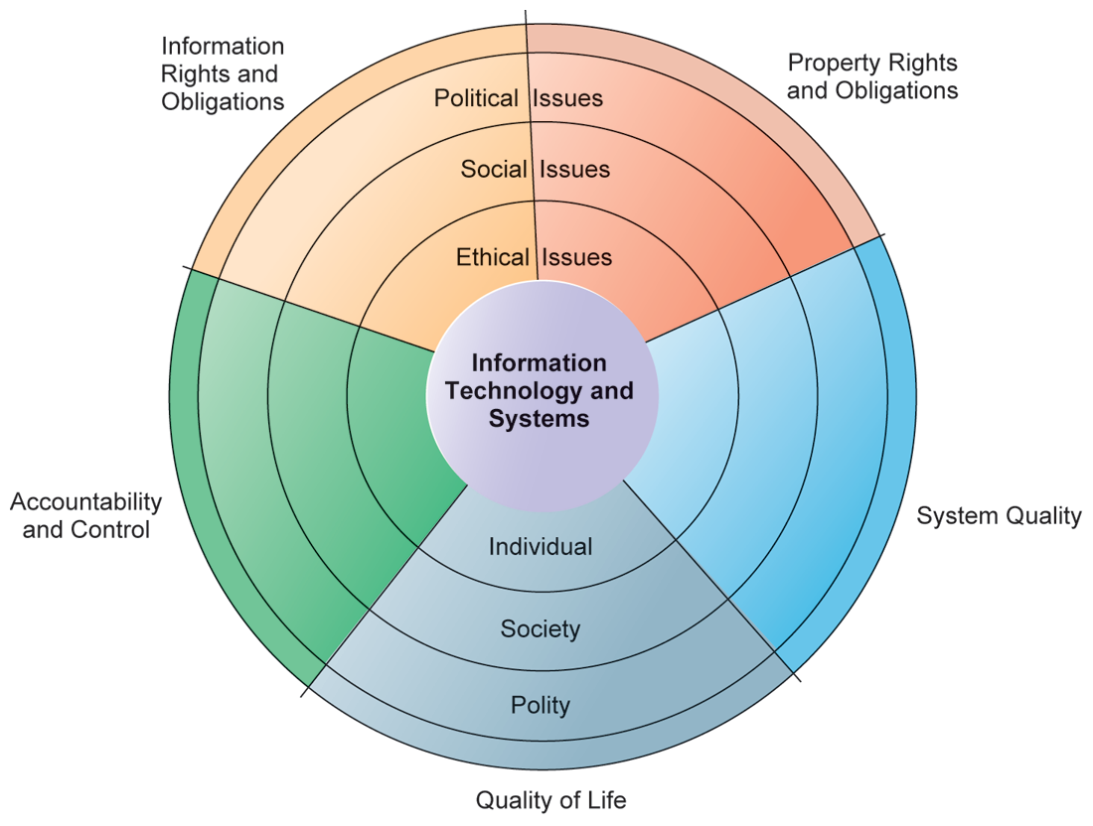
Understanding Ethical and Social Issues Related to Systems
THE RELATIONSHIP BETWEEN ETHICAL, SOCIAL, AND POLITICAL ISSUES IN AN INFORMATION SOCIETY
The introduction of new information technology has a ripple effect, raising new ethical, social, and political issues that must be dealt with on the individual, social, and political levels. These issues have five moral dimensions: information rights and obligations, property rights and obligations, system quality, quality of life, and accountability and control.
Notes:
Explain to students that the graphic displays the five moral dimensions listed in the caption. Consider online p2p shared music as an example of how a new technology has ethical, social, and eventually political (legal) ramifications. If music can be ripped off, why pay any money for it? Why should anyone care about record labels or artist’s income?

Slide 8
Understanding Ethical and Social Issues Related to Systems
Five moral dimensions of the information age
  Information rights and obligations
  Property rights and obligations
  Accountability and control
  System quality
  Quality of life
Notes:
Give examples of each of the five major issues. For example, an issue dealing with information rights might be, “What rights do individuals possess with respect to themselves?” What do they have a right to protect? An issue dealing with quality of life might be, “What values should be preserved in an information- and knowledge- based society?” An issue dealing with system quality might be, “What standards of data and system quality should we demand to protect individual rights and the safety of society?”

Slide 9
Understanding Ethical and Social Issues Related to Systems
Key technology trends that raise ethical issues
  Doubling of computer power
    More organizations depend on computer systems for critical operations
  Rapidly declining data storage costs
    Organizations can easily maintain detailed databases on individuals
  Networking advances and the Internet
    Copying data from one location to another and accessing personal data from remote locations is much easier
Notes:
This slide and the next discuss four main technology trends that raise ethical issues. Which of these trends do students believe might have the most adverse consequences? Why do they feel this way? Do the positives outweigh the negatives for all four issues? Why or why not?

Slide 10
Understanding Ethical and Social Issues Related to Systems
Key technology trends that raise ethical issues (cont.)
  Advances in data analysis techniques
    Companies can analyze vast quantities of data gathered on individuals for:
      Profiling
        Combining data from multiple sources to create dossiers of detailed information on individuals
      Nonobvious relationship awareness (NORA)
        Combining data from multiple sources to find obscure hidden connections that might help identify criminals or terrorists
Notes:
Online profiling is one of the most controversial computer-related ethical, social and political issues today. While it is used fairly extensively on the Internet, it is also used by insurance firms, health insurance firms, casinos, and of course national authorities around the globe for finding potential terrorists.

